Slide 1
PSYC 741 Hierarchical Linear Modeling
Session 4 – goodness of fit in multilevel models and random intercept models

Slide 2
Overview of Today’s Class
Lecture and Discussion
Goodness of Fit and Effect Size in Multilevel Models
Random Intercept Models
R tutorial
Aggregating Level-1 variables into Level-2 variables
Random intercept models using lmer()
In-Class Assignment

Slide 3
Goodness of Fit and Effect Size in Multilevel Models
Likelihood estimates
Information criteria measures
Effect size measures

Slide 4

Model Deviance
-2 * the log-likelihood (-2LL)
Measure of “model error”
Lower values imply less error
Distributed as a chi-square value
Does not penalize based on model complexity/parsimony
Notes:
Multiplying by -2 makes the error a chi-square distribution
Not relevant to compare models (if they have different sample sizes)

Slide 5
Likelihood Ratio Tests
Used to compare nested models to evaluate models and effects
Likelihood-based methods require ML (not REML) when fixed effects differ between the models being compared

Slide 6
Information Criteria Measures
Information Criteria Measures are measures of model fit that generally modify model deviance with some type of penalty term
Information criteria can “sometimes” be used to compare non-nested models
However, same data set (i.e., sample size) still needs to be used for the comparison models

Slide 7


AIC
Akaike Information Criterion (AIC)
Formulas differ based on statistical program. Some common formulas:
p = the number of parameters in the model
f = the number of fixed effects
$$AIC=−2LL+2p$$
$$AIC=−2LL+2∗(p+f)$$
Notes:
For smaller sample, use AIC
AIC prioritizes good predictions more than the true model, as n becomes larger AIC will always select the more complex model (with larger parameters)

Slide 8

BIC
Bayesian Information Criterion (BIC)
Formulas differ based on statistical program. One common formula:
p = the number of parameters in the model
n = either the Level 1 or Level 2 sample size
$$BIC=−2LL+p∗ln⁡(n)$$
Notes:
For larger sample sizes – Use BIC
BIC is stricter and aims to find the true model, but it might miss some complexity in the data. —> selects simpler model

Slide 9
Other Information Criteria Measures
ABIC: Adjusted BIC
Lower penalty for lack of parsimony than BIC
AICC: Corrected AIC
Adjustment to AIC to compensate for small sample size and model misspecification
CAIC: Consistent AIC
Alternative to AICC for penalizing for lack of parsimony in small samples
HQIC: Hannan-Quinn Information Criterion
Moderate penalty for lack of parsimony (e.g., between AIC and BIC)
DIC: Deviance Information Criterion
Relevant when using Bayesian estimation

Slide 10
Effect Size Measures
No consensus on how effect sizes for multilevel models should be estimated and/or reported
Effect size measures such as R-square are straight forward in single-level (OLS) models, because variance to be explained exists at only one level
More complicated in multilevel data because there exists variances in the DV at multiple levels

Slide 11
Proportional Reduction in Variance (PRV)
PRV formulas estimate changes in variance (whether Level 1 or Level 2) of the DV explained when predictors are added to the model.
PRVs assume:
Covariance structure constraining random effects to be independent of each other (only relevant when multiple random effects included in the model).
ML (and not REML) used as the estimator of the models.

Slide 12
Between-group variance explained
Particularly relevant when you want to judge the meaningful impact of adding Level 2 predictors to the model
E.g., If you wish to add school-level predictors to a model to explain the impact of school on individual student achievement scores
The contrast is between the random intercept variance in the null model compared to the model with the Level 2 predictor(s) included
$$BG−PRV=(VarLevelNull−VarLevelFull)/VarLevelNull$$
VarLevelNull = variance component for the group variable in the null model
VarLevelFull = variance component for the group variable in the larger model
Notes:
BG – PRV can be done for random slope model
OR both slope and intercept as long as they don’t covary (Variance Component/ VC ) and NOT unstructured (UN)

Slide 13
Within-group variance explained
Particularly relevant when you want to judge the meaningful impact of adding Level 1 predictors to the model (though Level 2 predictors still okay to include)
E.g., If you wish to add student-level predictors to a model to explain individual student achievement scores within schools
The contrast is between the residual variance in the null model compared to the model with the Level 1 predictor(s) included
$$WG−PRV=(ResidNull−ResidFull)/ResidNull$$
ResidNull = residual variance component for the null model
ResidFull = residual variance component for the larger model

Slide 14
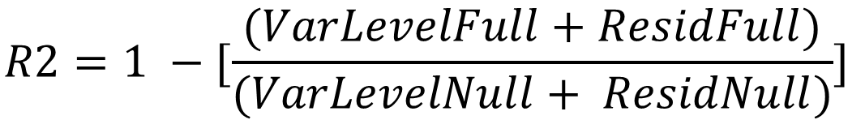
R-square and Pseudo R-square Estimates
May be particularly relevant when trying to estimate a percentage of variance explained for a full model with Level 1 fixed effect(s) included.
Example formula:
$$R2=1 −[\frac{(VarLevelFull+ResidFull)}{(VarLevelNull+ ResidNull)}]$$

Slide 15
Random Intercept Models
Overview
Example from textbook
Aggregate variables
Interpretation of fixed effects predictors

Slide 16
Random Intercept Models (Overview)
A multilevel regression model with a random intercept included based on the group/clustering variable
The null model from last week is an example of a random intercept model
But, random intercept models can include fixed effect predictors too (whether Level 1 or Level 2 predictors)

Slide 17
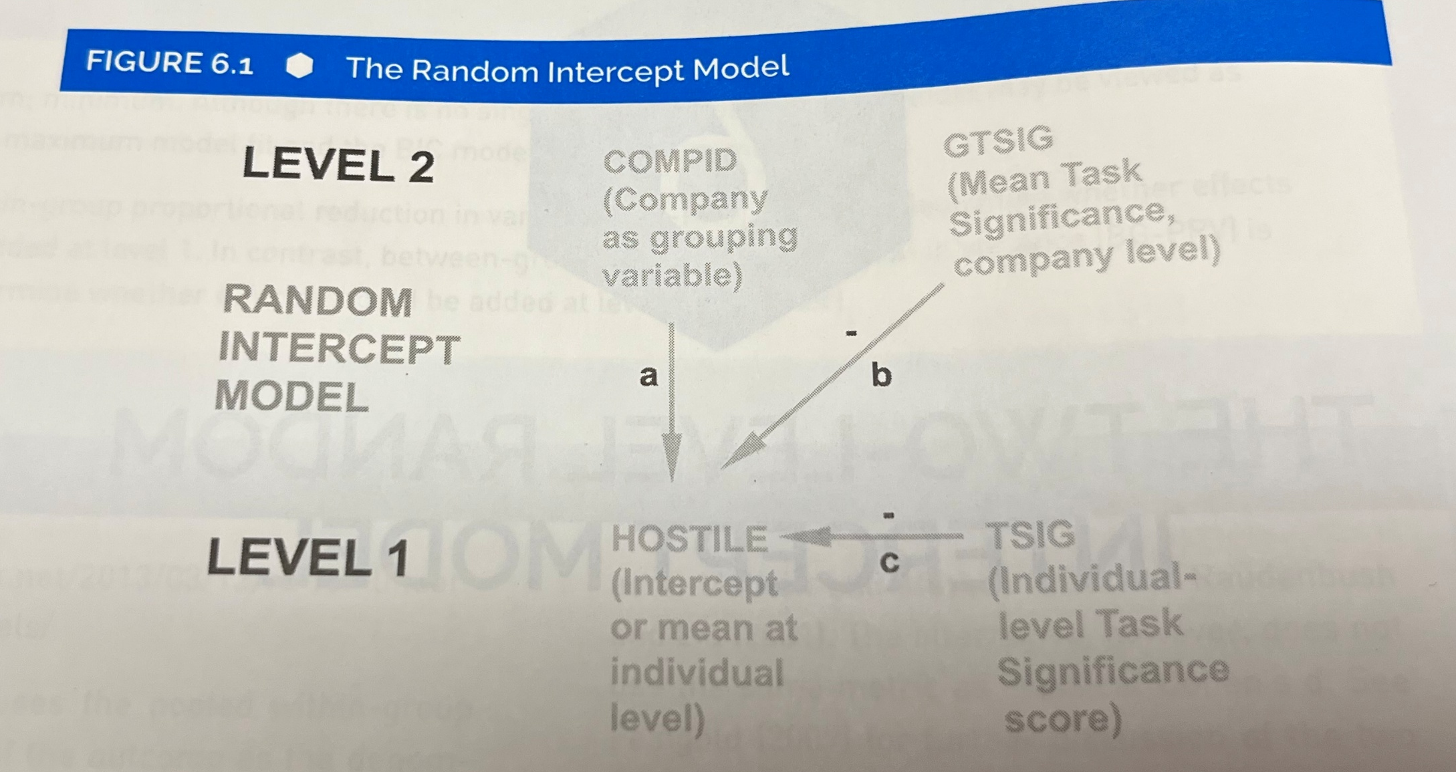
Example from Textbook

Slide 18
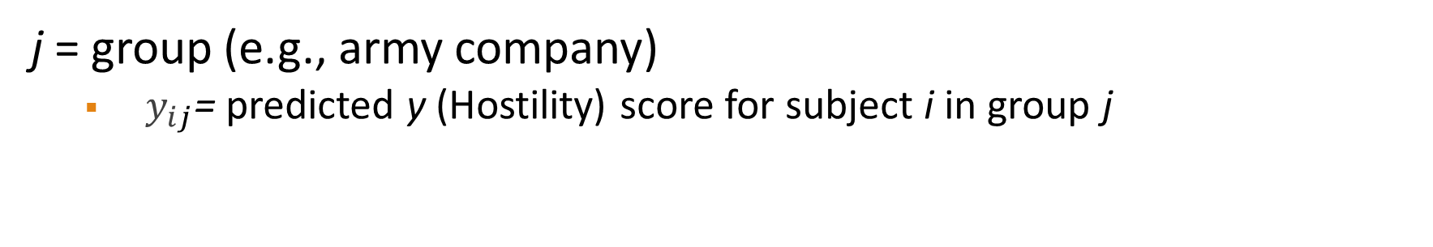
Example Formula
$$y_{ij}=β_{0_{j}}+{β_{1}∗\left(TSIG\right)+β_{2}∗(GTSIG)+ e}_{ij}$$
j = group (e.g., army company)
$y_{ij}$= predicted y (Hostility) score for subject i in group j

Slide 19
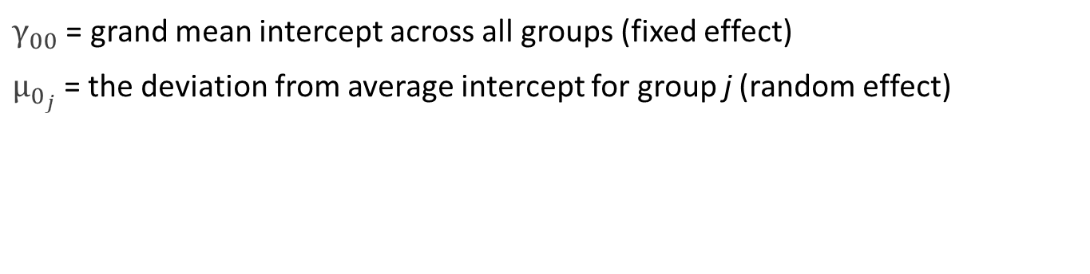

Random Intercept Included
$$y_{ij}=β_{0_{j}}+{β_{1}∗\left(TSIG\right)+β_{2}∗(GTSIG)+ e}_{ij}$$
$$β_{0_{j}}=γ_{00}+ μ_{0_{j}}$$
$$y_{ij}=γ_{00}+ μ_{0_{j}}+{β_{1}∗\left(TSIG\right)+β_{2}∗(GTSIG)+ e}_{ij}$$
$γ_{00}$ = grand mean intercept across all groups (fixed effect)
$μ_{0_{j}}$= the deviation from average intercept for group j (random effect)
Notes:
This Random Intercept Model - 5 Parameters
Null Model – 3 Parameters

Slide 20
Aggregate Variables
Sometimes you are interested in the effect of a variable at both the individual and group level on some outcome.
Example: the impact of family income and the average household income of a school district on the academic outcomes of individual students.
If the Level-2 version of the variable is not already created, you can aggregate together Level-1 data points based on group identification to create it.

Slide 21
Interpretation of Fixed Effects Predictors
Similar as the interpretation from a traditional OLS regression model.
E.g., A one unit increase in X is associated with a B change in Y, adjusting for the influence of group/cluster on Y.
The general interpretation is similar for Level 1 and Level 2 fixed effects.
Level 1: A one-unit increase of X1 at the individual level is associated with a B1 change in Y…
Level 2: A one-unit increase of X2 at the group level is associated with a B2 change in Y…

Slide 22
Next Class
Lecture Topics:
Random Slopes Models
R
Two-level Random Coefficients Models in R
Readings that will be discussed
Textbook Chapter 7
Contributing to your participation grade, make sure to respond to the Readings Feedback/Questions submission on Canvas
HW #1 due
Notes:
Saturated model represents a model that includes all possible relationships between variables, perfectly fitting the data by having a parameter for every variance and covariance,
while an Unsaturated model is a model with fewer parameters than the available data, meaning it does not capture all possible relationships and therefore does not perfectly fit the data

